Slide 1
Title & Project Overview
Project Title: Automated Gaming Top-Up & Database Management System
​Student Name: Hassan
ID: 31314/2025
​Course Code: Computer Science - Advanced Database Systems
​Supervisor: Dr. Eric

Slide 2
Project Objectives & Scope
​Aiming to design and implement a secure, scalable Oracle-based database infrastructure for gaming digital distribution.
​Provides seamless transactional processing for multi-platform game top-ups (PUBG Mobile, Free Fire, Call of Duty).
​Enforces strict computational data integrity, operational holiday tracking, and zero-redundancy normalization

Slide 3
Requirements Analysis
​User Management: Secure profiles for Players containing history tracking and loyalty metadata.
​Catalog Control: Dynamically updated pricing logs for specific regional TopUp Items and Games.
​Order Execution: Fully automated verification logic managing payment status, order tracking, and public holiday compliance.

Slide 4
Problem Statement & Solutions
High Demand: Rapid growth in Rwanda's gaming and esports market for automated digital currency.
​Manual Bottlenecks: Heavy reliance on scattered text messages and manual broker verification.
​System Risks: Frequent transaction delays, product misdelivery, and critical data loss due to a lack of centralized logs.
​The Solution: A secure, automated relational database that ensures instant, error-free game top-ups.

Slide 5
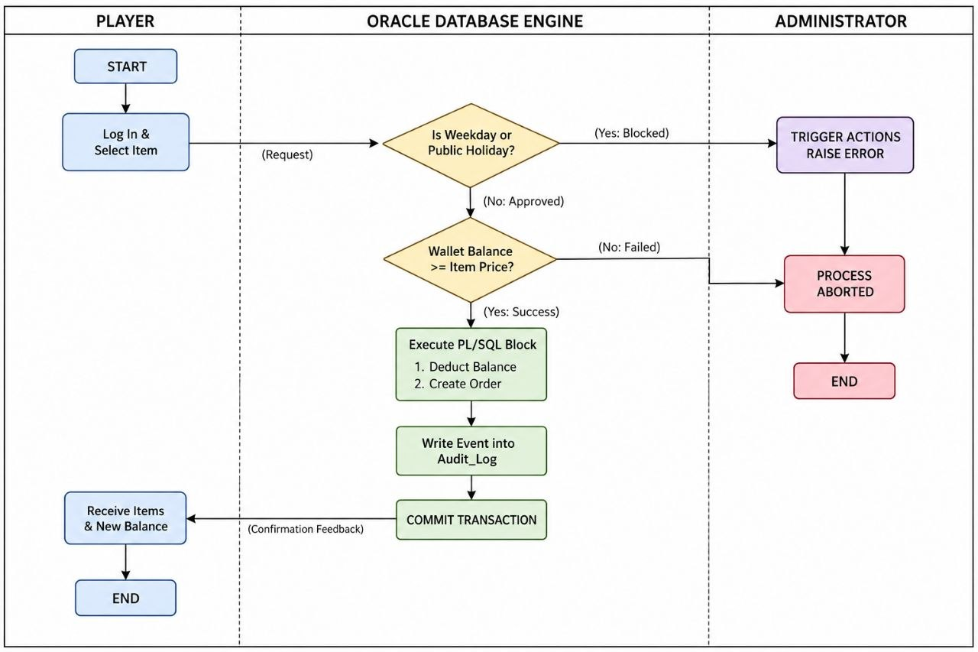
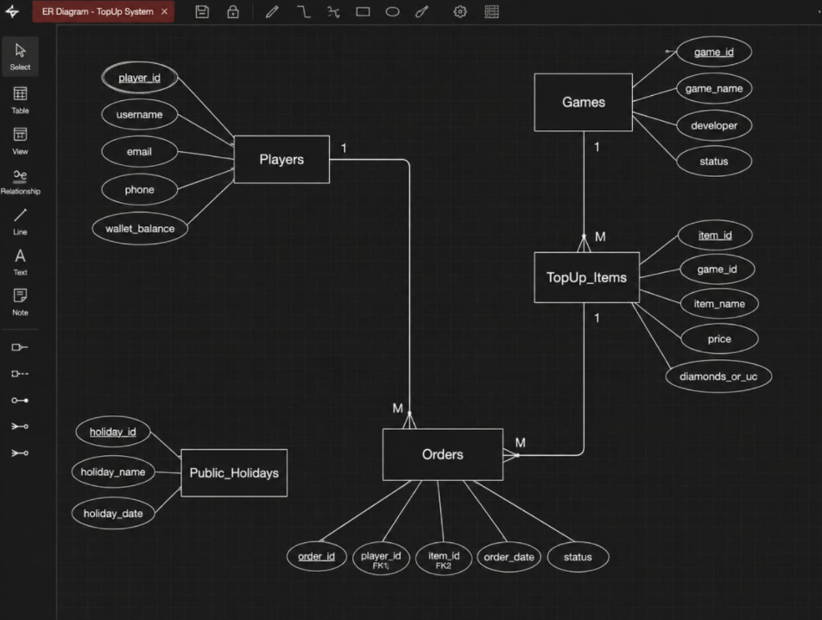
Business Process Modeling: Mapped full operational workflows using structured BPMN swimlanes. ​Logical Database Design: Developed a comprehensive 5-entity relational schema (Games, Players, TopUp Items, Orders, Holidays). ​Data Integrity (3NF): Applied complete mathematical normalization up to Third Normal Form (3NF).
Methodology & Logical Design

Slide 6
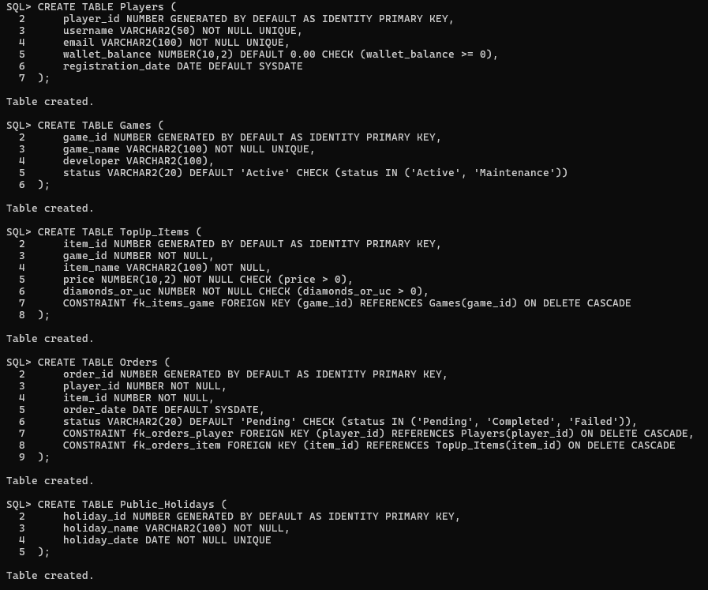
Physical Design & Oracle Implementation
​Transformed logical models into operational SQL deployment packages under Oracle database infrastructure.
​Enforced physical relational schema constraints, primary keys (PK), and cross-table foreign keys (FK).

Slide 7
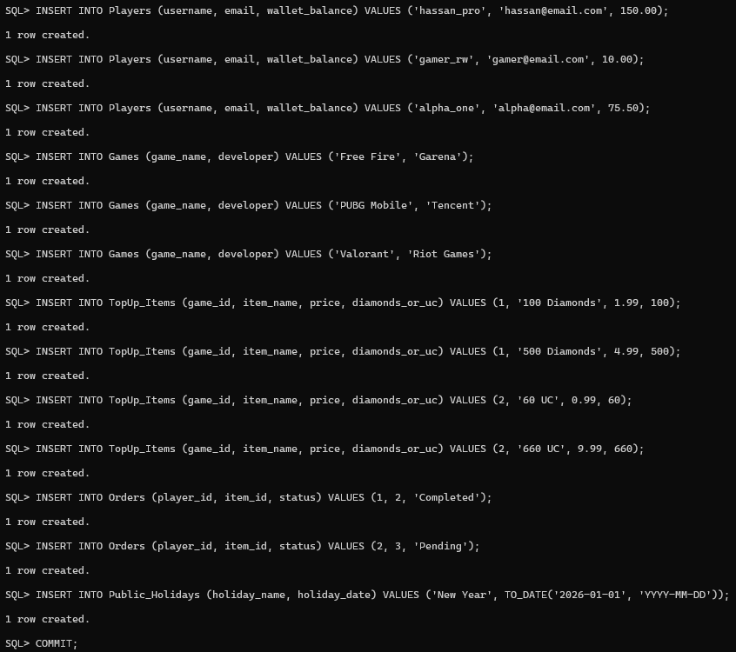
Population of Tables & Test Data
​Seeded the database with clean, realistic operational records across all relational tables.
​Validated referential integrity constraints during bulk data entry and records creation.

Slide 8
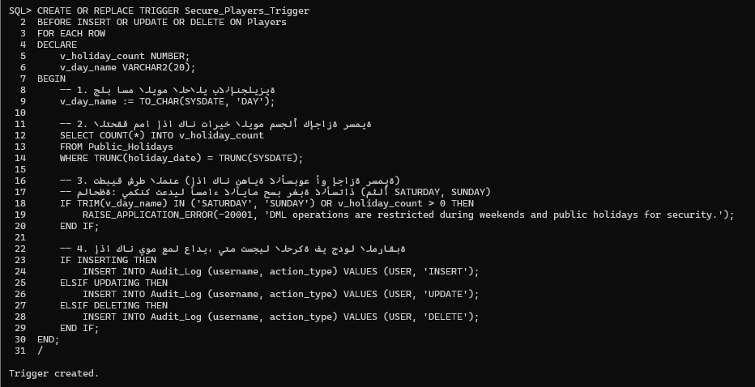
Queries & Advanced Implementation
​Developed robust SQL queries utilizing multi-table JOIN statements and conditional data aggregations.
​Extended database programming features by implementing custom database PL/SQL Functions and Triggers to automate process flows.

Slide 9
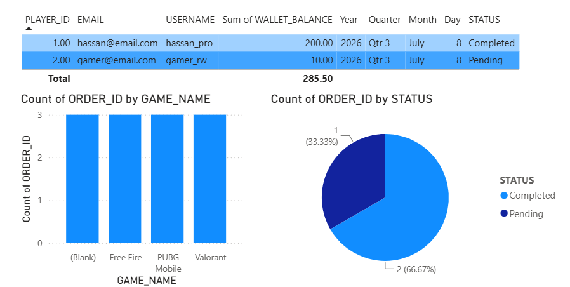
Innovation Component (Power BI Dashboard)
​Integrated the system's operational backend dataset with Microsoft Power BI for live executive business intelligence.
​Generates real-time analytical insights tracking total revenue and revenue distribution across active titles.

Slide 10
Conclusion & Future Enhancements
​Conclusion: Designed and fully implemented a production-ready, fully normalized (3NF) relational database for automated game top-ups under Oracle environment.
​Future Work: Planning to deploy a live web front-end application interface and integrate direct automated payment gateways (Visa/Mastercard/Apple Pay).

